Slide 1
Drilling Electronics Tools Failure Risk and Lifetime Prediction (ELP) & Condition based Maintenance

Slide 2
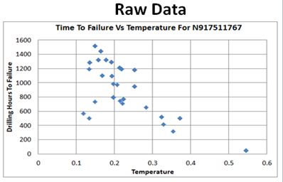

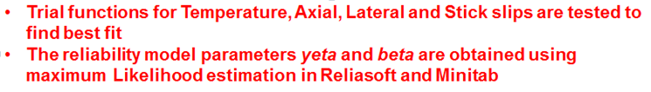
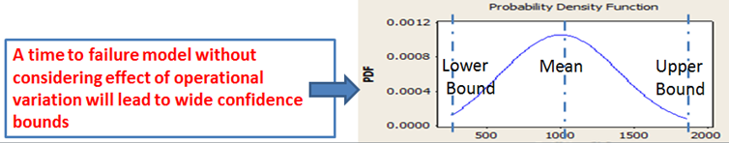
Reliability Model

Slide 3
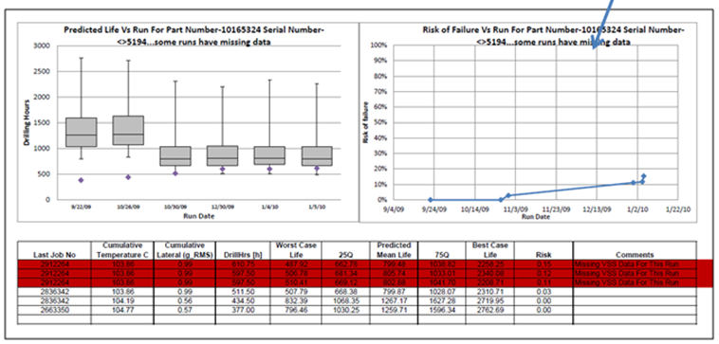
Prediction & Visualization

Slide 4
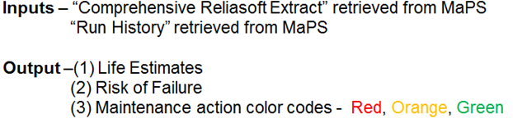
CBM (Predictive Maintenance) Tools

